Slide 1


Slide 2

Announcements
Memberships (this is the last free session)
CTF Club
Hack The Box University CTF Competition
If you would like to take part let a committee member know and we shall add you to the channel for the event
Takes place 13th 1300 - 15th 2200 Dec
Christmas Meal (28th Nov deadline for ticket purchase)

Slide 3
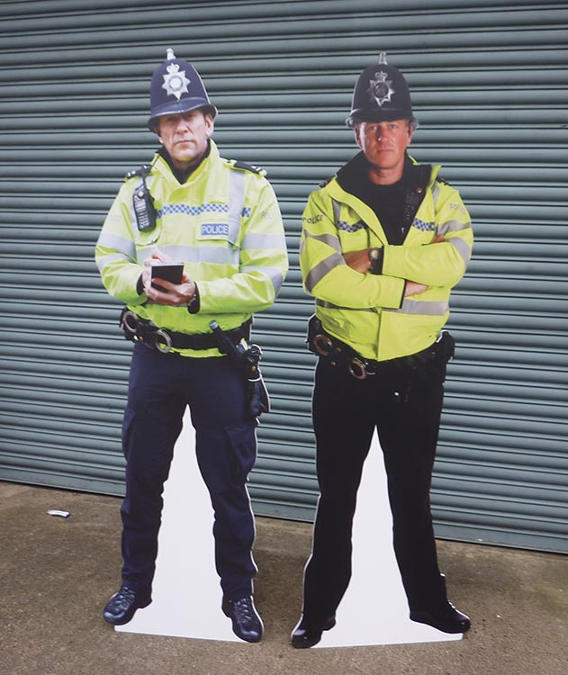


Ideally Don’t do Illegal Shit
(Not that you explicitly can with steg)

Slide 4
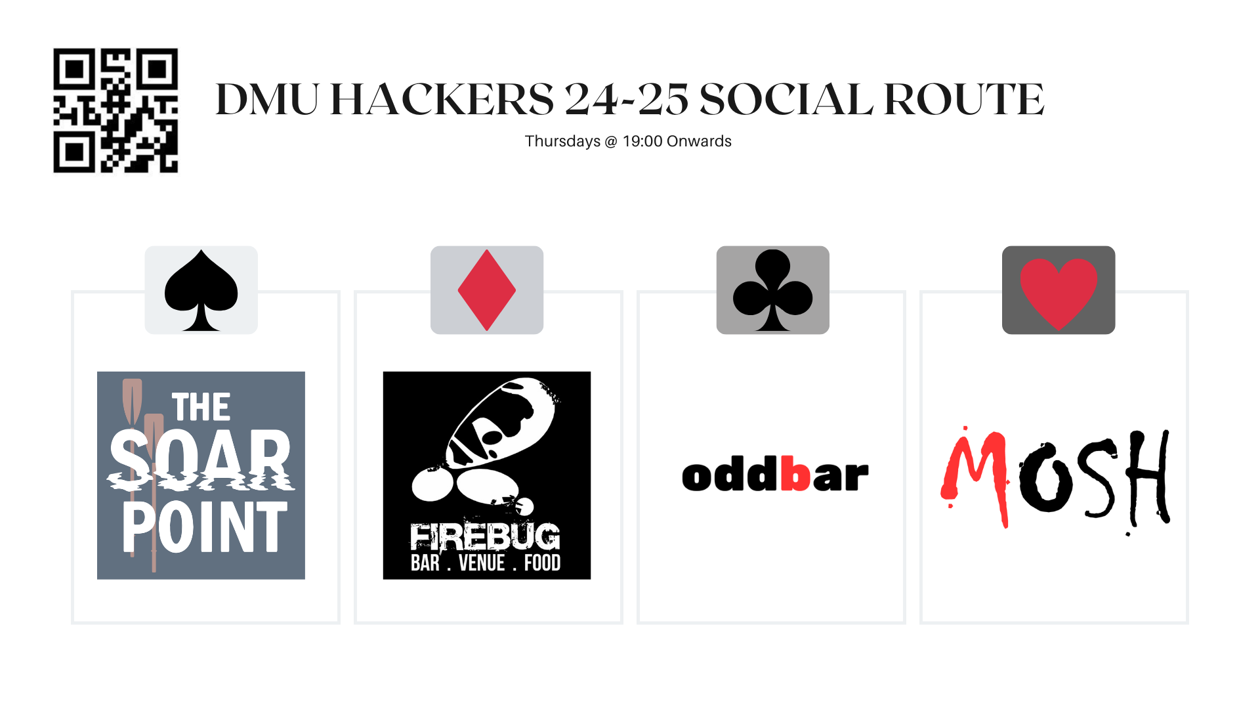
Notes:
Firebug student discount is all week and not just when we go out as a society

Slide 5

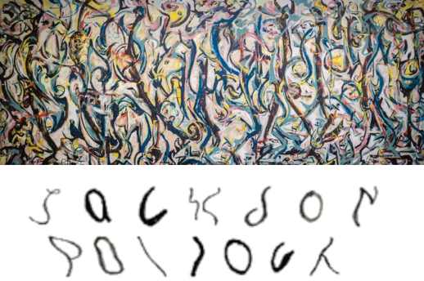
The Simple Breakdown: (what is steganography)
Steganography is, simply put:
Hiding of one thing inside something else.
For example, you can hide:
Messages in images
Images in messages
Basically anything when it comes to digital steganography.
Often used to obscure the fact a message is even being sent
Notes:
Worth noting that encryption is usually used within the programs used for steg

Slide 6

IT’S LIKE DIGITAL INVISIBLE INK
Notes:
Worth noting that encryption is usually used within the programs used for steg

Slide 7
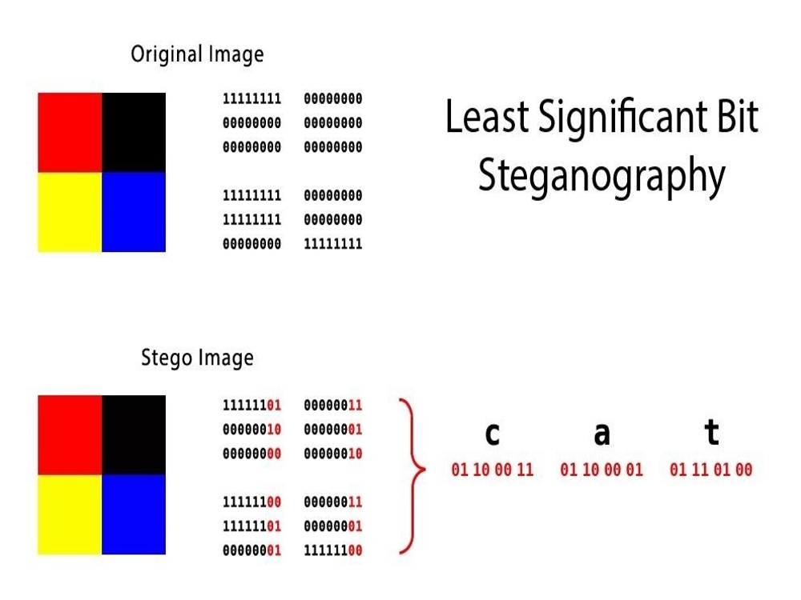
An example of how it works: (in images)
You have a ‘cover’ image, which is made up of pixels.
Each pixel has a LSB/‘least significant bit’ (whereby altering it will not really change the perceivable colour value)
We store values that make up our data within the LSB
Then to read the data, we obviously just read the LSBs
Notes:
Worth noting that encryption is usually used within the programs used for steg

Slide 8
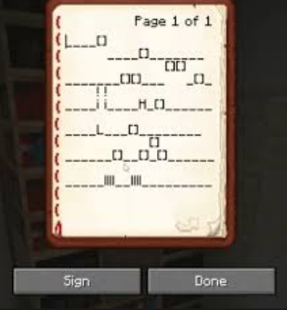
It was written in parkour
BOTTOM TEXT
Notes:
DO NOT REFERENCE THIS SLIDE [BOTTOM TEXT]

Slide 9
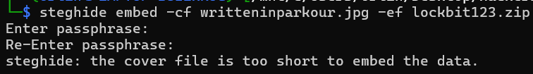
Using steghide to hide messages in images/audio files
To embed a file in any sort of file:
steghide embed -cf [file to hide stuff in, ‘cover file’] -ef [file to hide, ‘embed file’]
Supported file types include:
JPEG, BMP, WAV and AU files
If ‘cover file’ isn’t big enough, steghide won’t work. It needs free space to work.

Slide 10
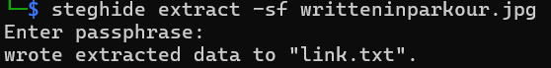
Using steghide to hide messages in images/audio files
To extract hidden data, simply:
steghide extract -sf [suspected steg file]
It’ll then prompt for the password used to encrypt the file (even if none was given) and once entered, will extract whatever was hidden in the file:

Slide 11
‘Message in message’ steg
When it comes to ‘message in message’ steg, tools do exist. Although I can’t find any verifiable and trustworthy tools that would work today.
A tool I did find, spam mimic, is a web-only tool. Which obviously can’t be fully trusted, you’re sending them your message to decode. But it seems to work.

Slide 12
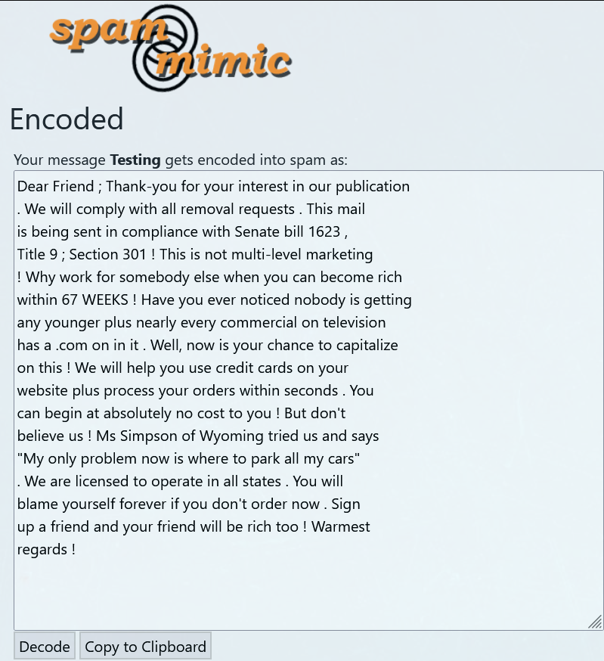
‘Testing’ turns into:
We can see where the ‘spam’ part of the name came from…

Slide 13
Audio Steganography
Audio steganography can mean a few things, for example:
Hiding data within the waveforms of sound files. Which can be seen by programs such as audacity.
Hiding messages within the audio.
Hiding data within the metadata (exiftool)

Slide 14
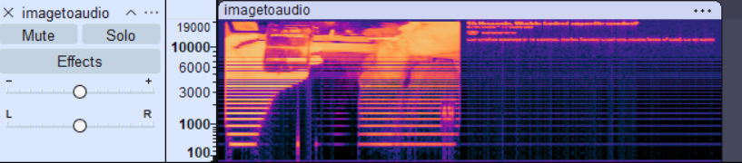
Waveform Steganography
Data can be hidden in the spectrograms of files, using image synth tools. E.g. https://nsspot.herokuapp.com/imagetoaudio/

Slide 15


Audio Steganography
Messages can be hidden inside the audio itself too, think similar to the songs that play ‘demonic messages’ when reversed. (AKA backmasking)
I fw it ever so slightly

Slide 16
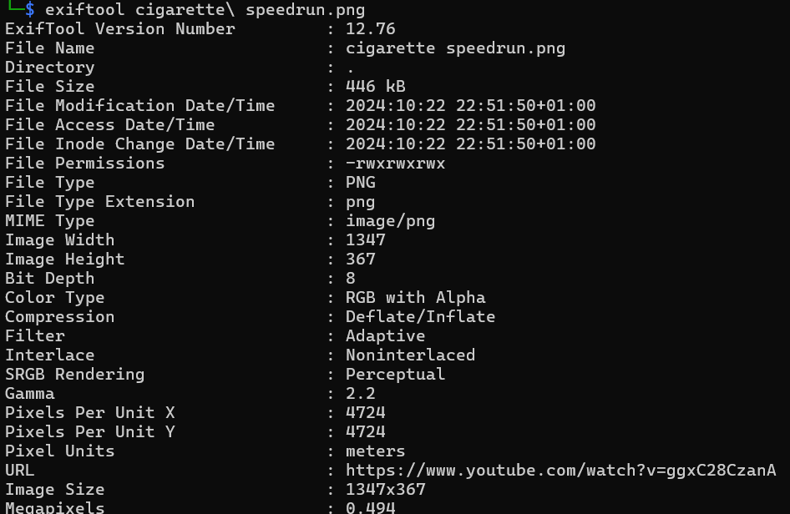
Metadata Steganography
A tool called ‘exiftool’ can be used to both add metadata, and retrieve metadata from. Key points:
Lots of file types supported (video, audio, image, document) but not all.
Easy to add data to files.
Easy to use to retrieve data.

Slide 17

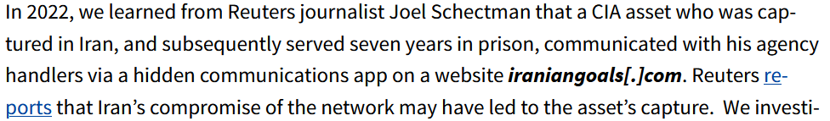
Steganography examples:
This is (was) a website used for agents to communicate with the CIA, in a ‘covert’ way.
Apparently led to the death of 2 dozen sources for the CIA, because the website was insecure. (and not a great cover)

Slide 18



Your turn!
github.com/dmuhackers
tryhackme.com/jr/dmuhackerssteg2h

Slide 19
Resources
https://citizenlab.ca/2022/09/statement-on-the-fatal-flaws-found-in-a-defunct-cia-covert-communications-system/ - citizen lab report on CIA websites used to communicate with agents
https://www.reuters.com/investigates/special-report/usa-spies-iran/ - reuters report on the same thing
https://medium.com/@AungKyawZall/audio-steganography-39f9fb6d9330
https://nsspot.herokuapp.com/imagetoaudio/ -> where i found the image to audio tool
https://www.mdpi.com/2076-3417/13/21/11771 -> LSB STEG
https://www.pantechsolutions.net/wp-content/uploads/2021/09/matlab_code_for_lsb_steganography.jpg - LSB graphic

